Slide 1
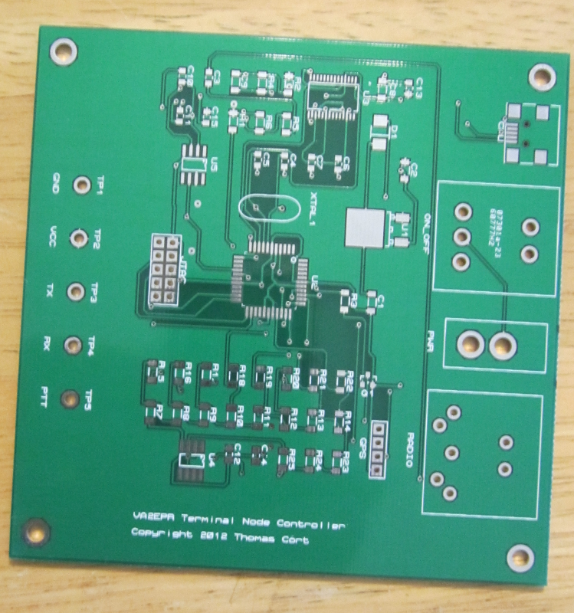
Terminal Node Controller Final Project
Thomas Cort

Slide 2
Motivation
Learning about digital communications.
Building a device that I will use.
Sharing my design and software with others.
Improving on existing technology.
Passing the course and graduating.

Slide 3
Outline
Introduction
Background Information
High Level Block Diagram
Schematic
Layout
Milestones
Statement of Feasibility
Questions

Slide 4
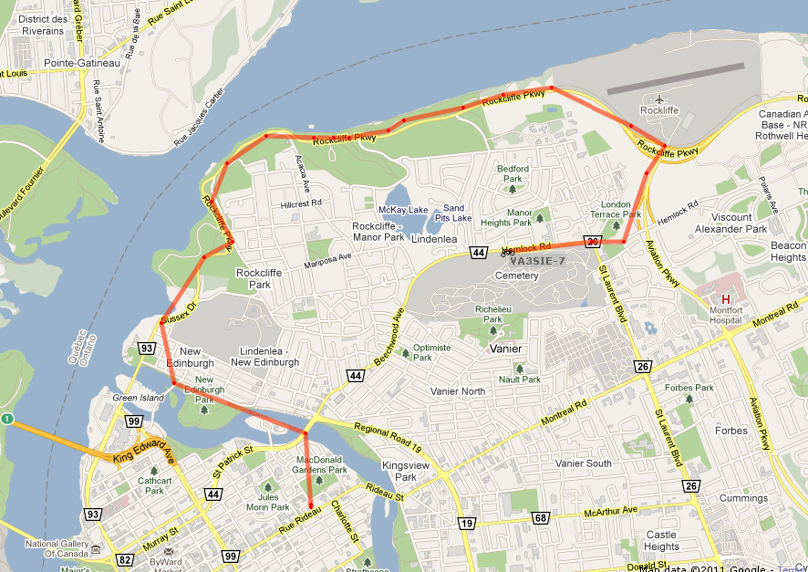
Introduction
Position Tracking System

Slide 5
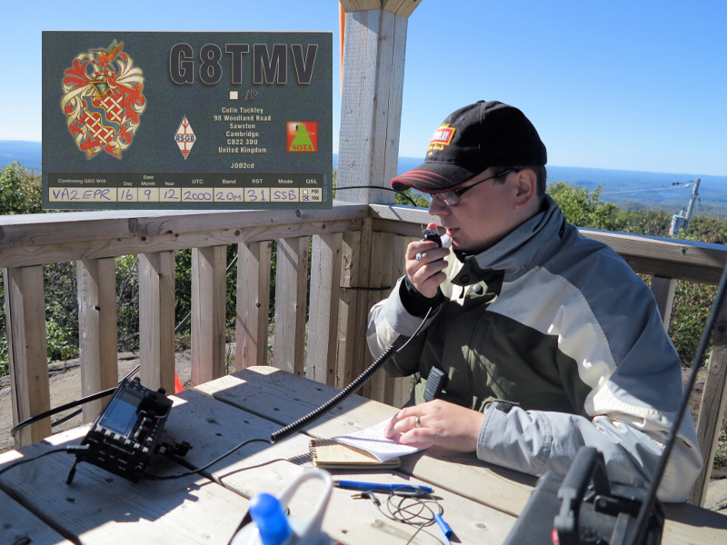
Background Information
Amateur Radio

Slide 6
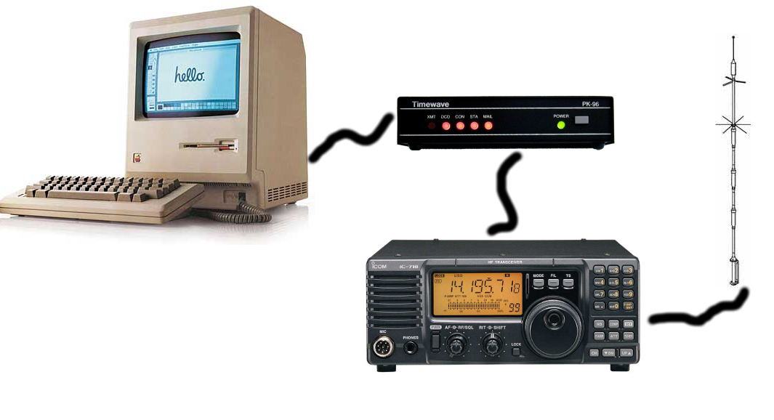
Background Information
Packet Radio Terminal Node Controllers

Slide 7
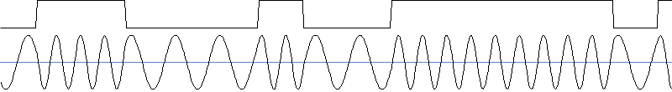
Background Information
Packet Radio Networks for Position Reporting
Network – APRS
Data link – AX.25
Physical – Bell 202 (1200 Baud AFSK NRZI)

Slide 8
Background Info
Here is some sample audio recorded off the air.

Slide 9
Goals
Modern
Reliable
Low-cost
Easy to use
Open design
Small form factor
Portable version

Slide 10
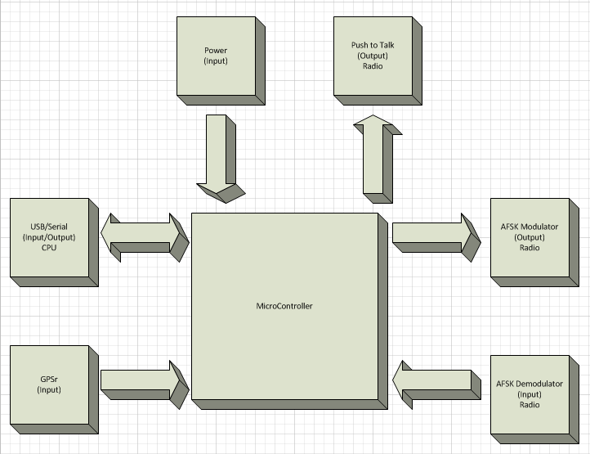
High Level Block Diagram

Slide 11
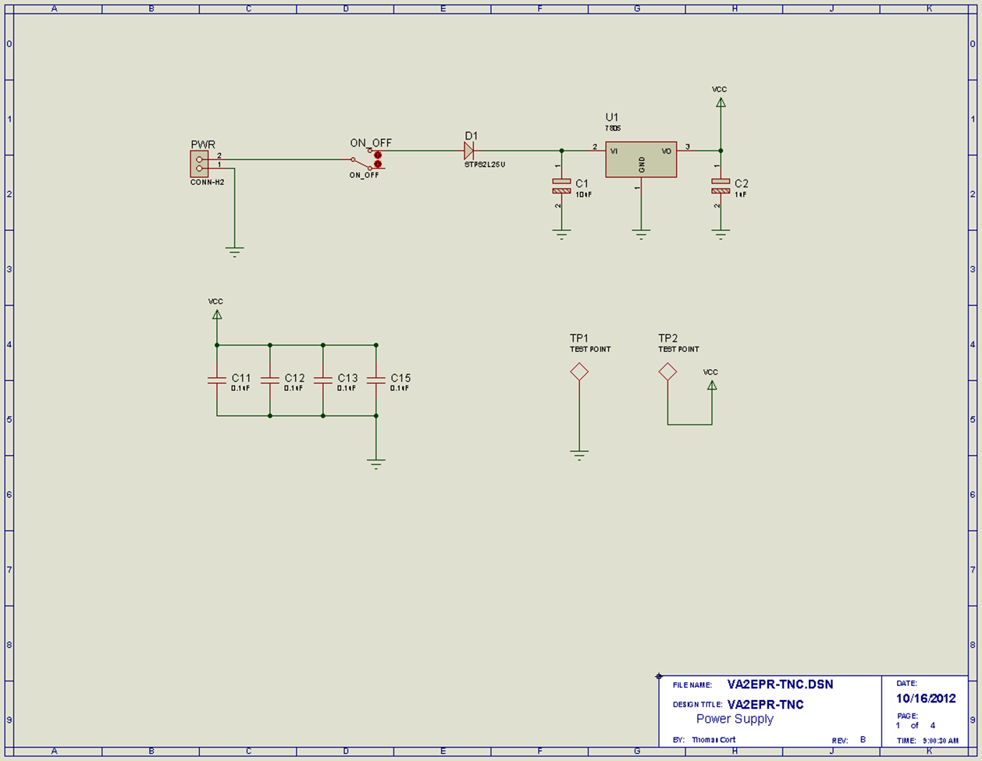
Schematic

Slide 12
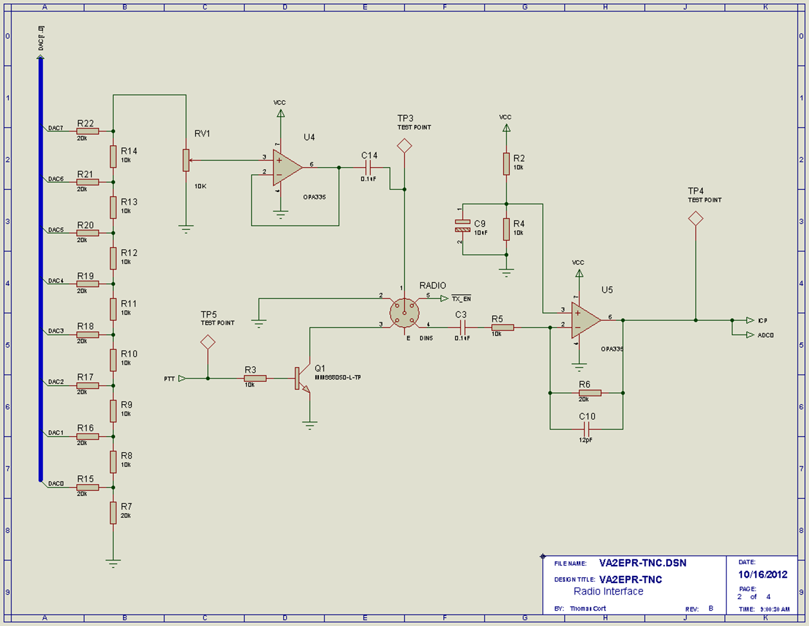
Schematic

Slide 13
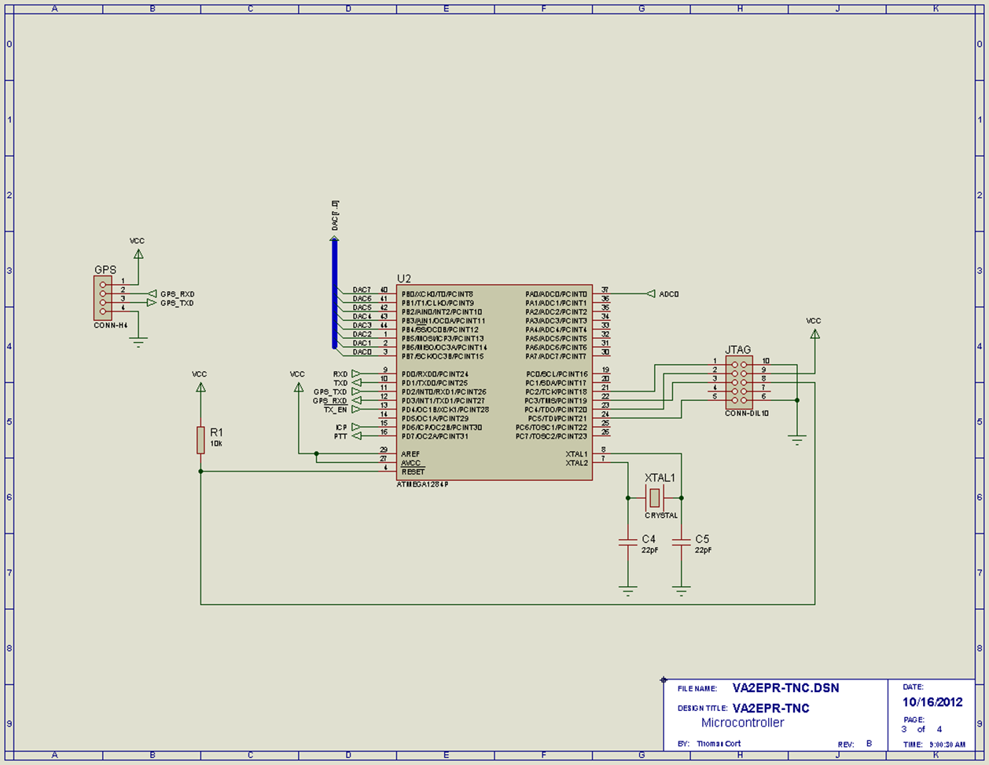
Schematic

Slide 14
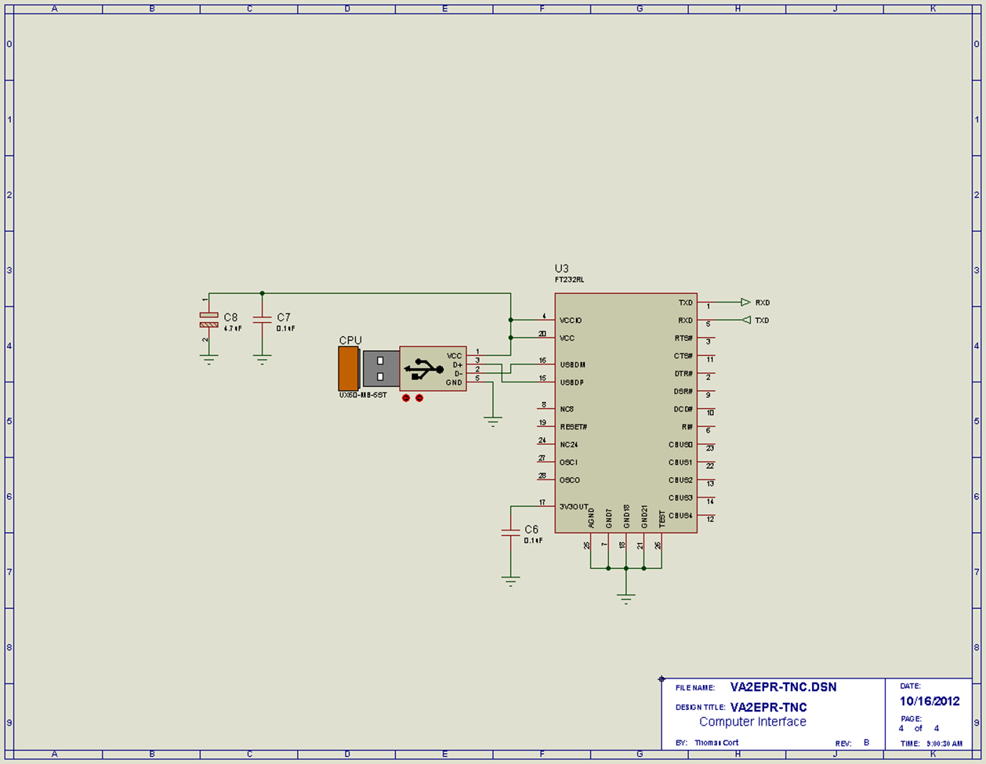
Schematic

Slide 15
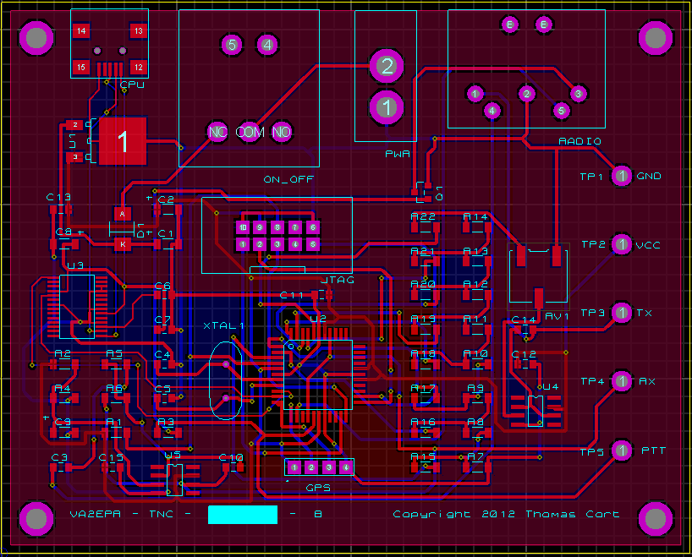
Layout

Slide 16
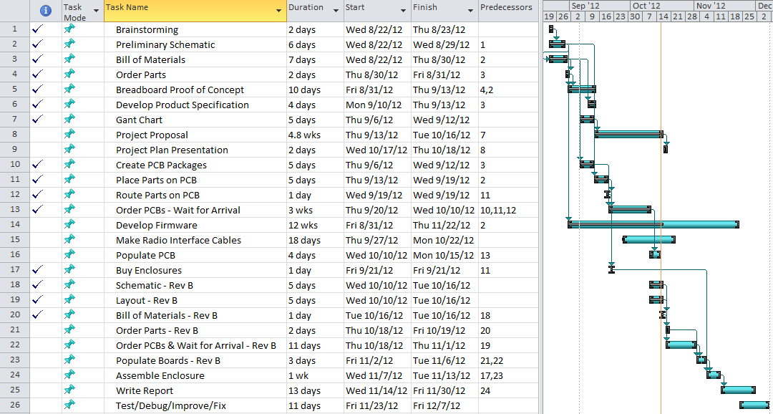
Milestones

Slide 17

Statement of Feasibility

Slide 18
The End
Questions?

